Slide 1
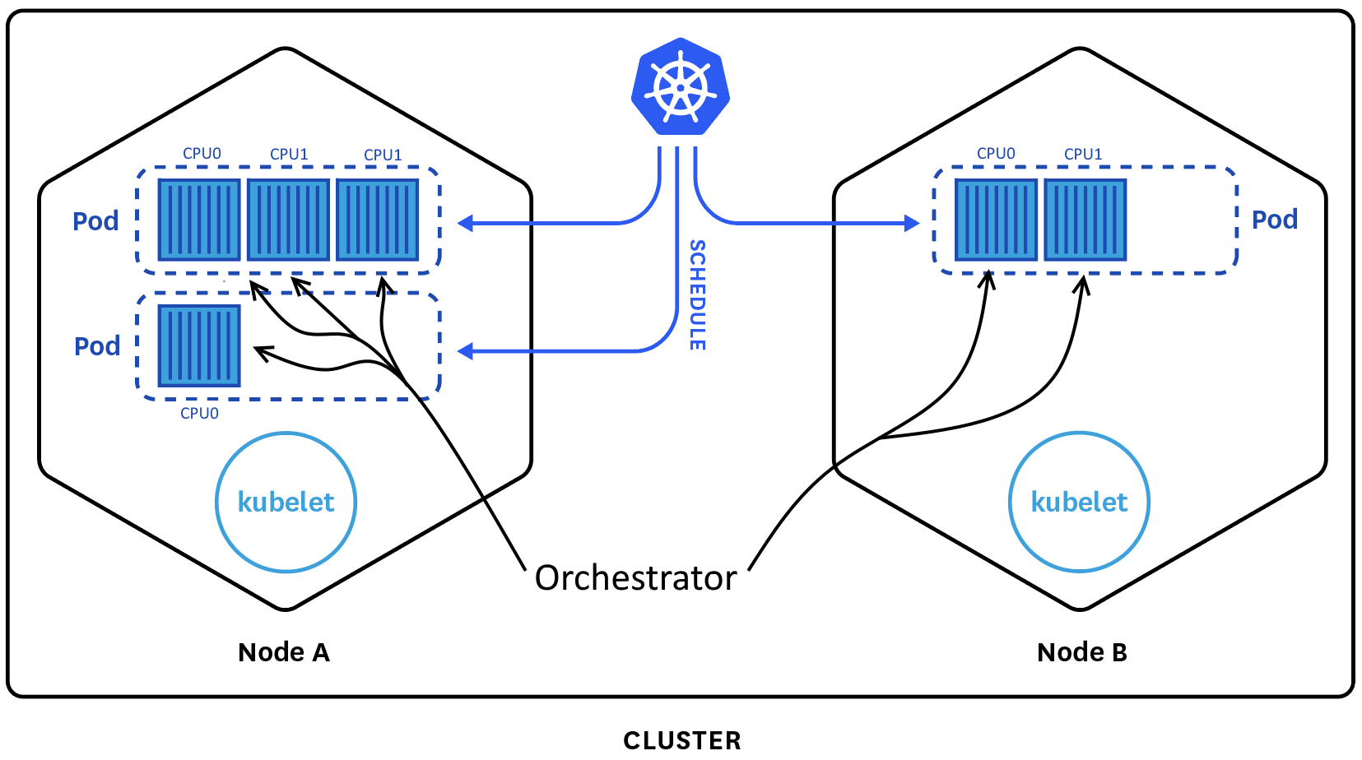
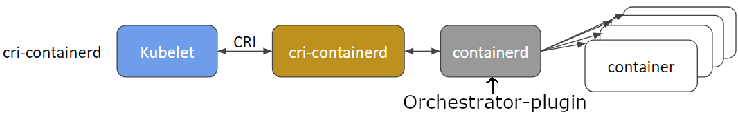
Comparison Kubernetes vs. Orchestrator
Kubernetes:
Allocates pods (and their containers) on nodes based on the required resources and/or tags
Limits the maximum CPU-time and memory of a container and a pod according to static configuration
May reallocate a pod’s container to an other node if needed
Orchestrator:
Manages containers on local resources (CPU scheduling), configures the system and resources such as softIRQs and other latency-causing factors
Monitors real-time behavior and reallocates local resources during runtime to maintain determinism if needed
Tries to manage CPU-time on a node while keeping low firing latency for real-time applications
Possibility to create a plugin for containerd to integrate orchestration into Kubernetes seamlessly
New Kubernetes cri

